Slide 1
Data Analysis and Visualisation
Receiver Operating Characteristic (ROC) Curve

Slide 2
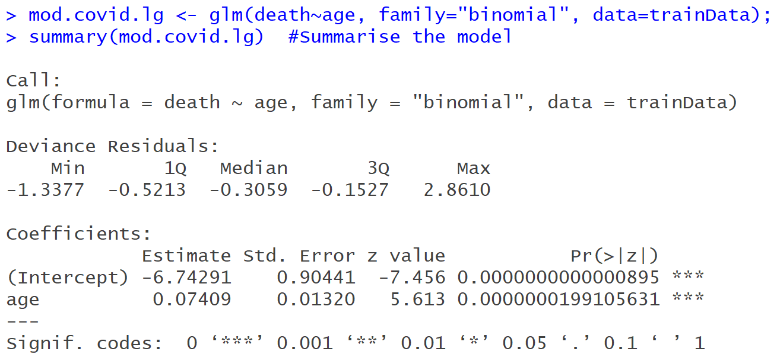

ROC Analysis
Suppose we wish to determine whether age with a person dying from contracting COVID-19 disease (Workshop 5).
Age is a significant predictor ($p<0.001$)

Slide 3
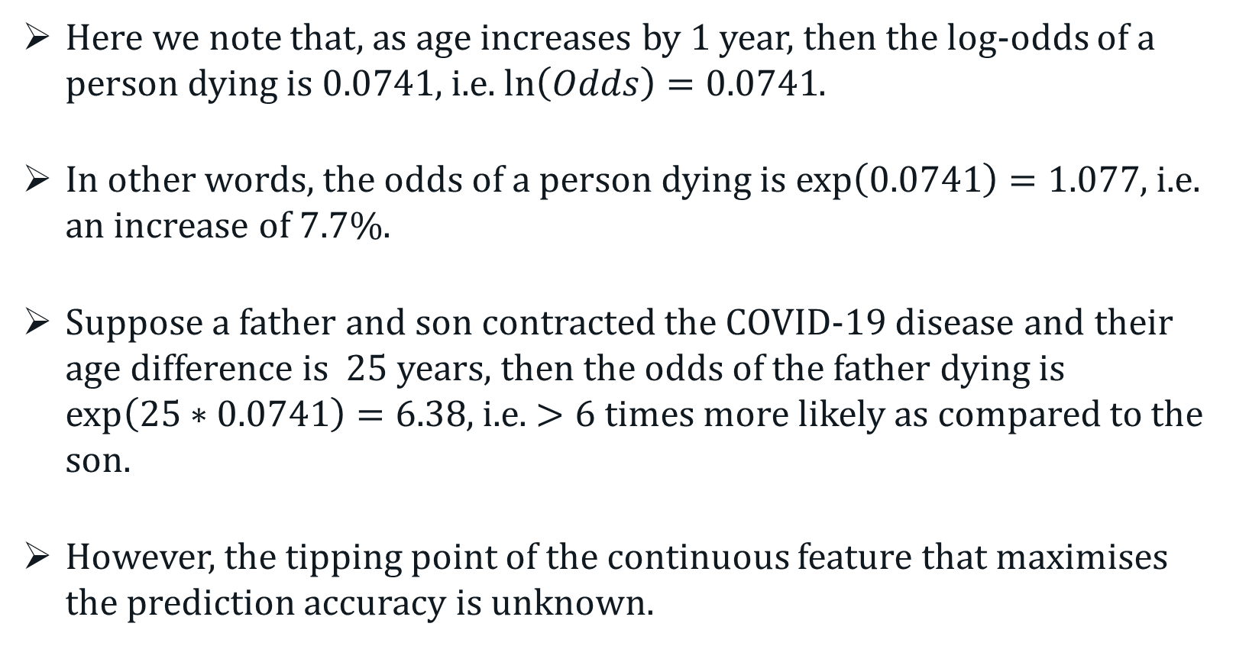
ROC Analysis
Here we note that, as age increases by 1 year, then the log-odds of a person dying is $0.0741$, i.e. $\ln\left(Odds\right)=0.0741$.
In other words, the odds of a person dying is $\exp\left(0.0741\right)=1.077$, i.e. an increase of 7.7%.
Suppose a father and son contracted the COVID-19 disease and their age difference is 25 years, then the odds of the father dying is $\exp\left(25∗0.0741\right)=6.38$, i.e. $>6$times more likely as compared to the son.
However, the tipping point of the continuous feature that maximises the prediction accuracy is unknown.

Slide 4
ROC Analysis
ROC analysis is a technique that allows us to establish this cut-off for the continuous predictor.
It was developed in WWII by US engineers for detecting enemy objects in radar images in the presence noise.
Use frequently in radiology, medicine, biometrics and etc.
A ROC analysis provides a diagnostic on predictor(s) as a binary classifier as the discrimination threshold varies.
A ROC curve provides a graphical way to show the trade-off between sensitivity (TPR) and specificity (TNR) for every possible cut-off.

Slide 5
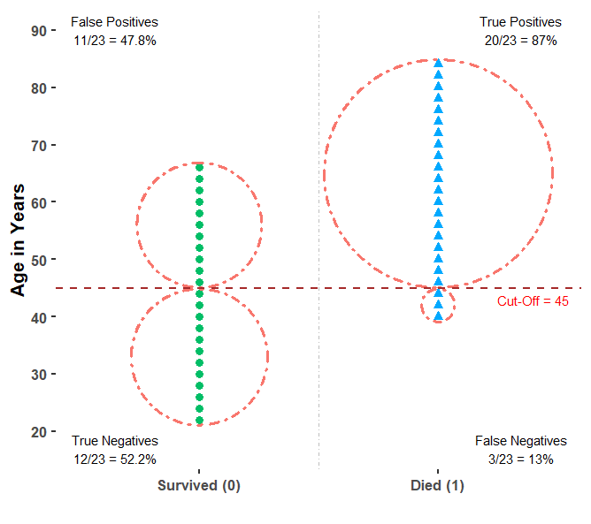
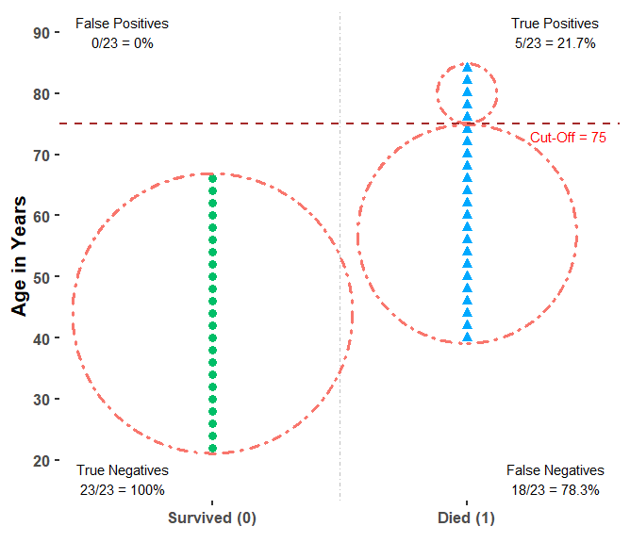
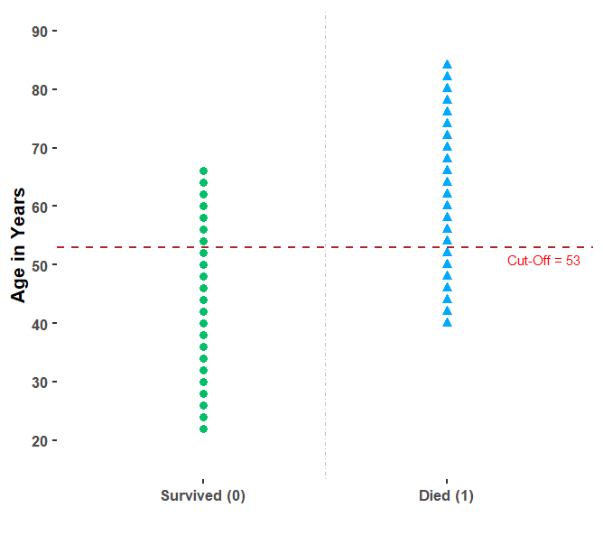
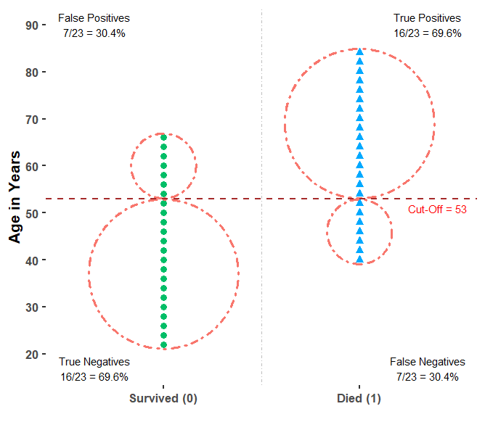
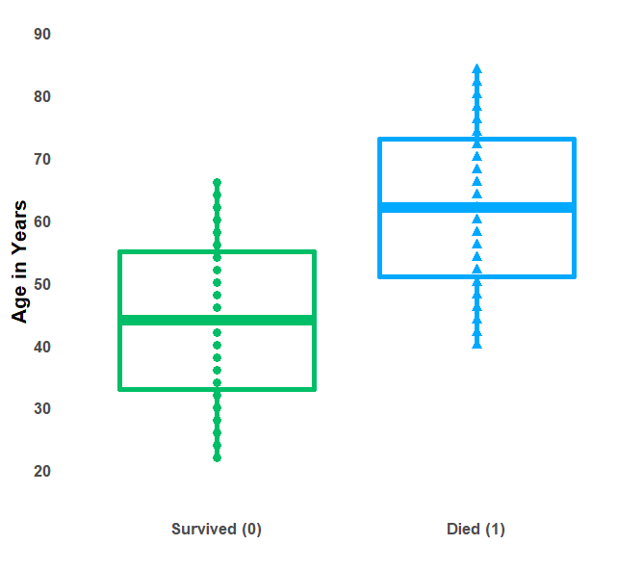
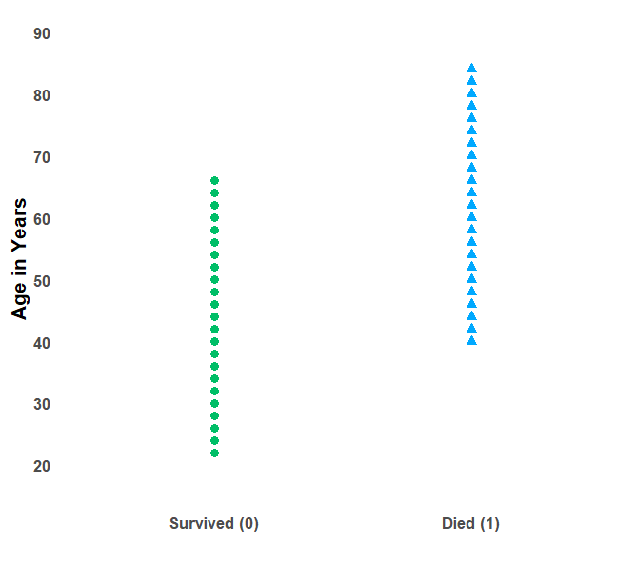
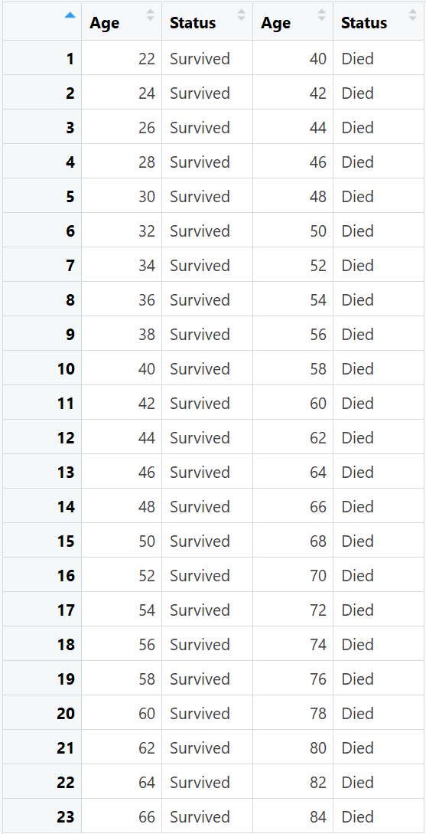
ROC Analysis
Example:

Slide 6
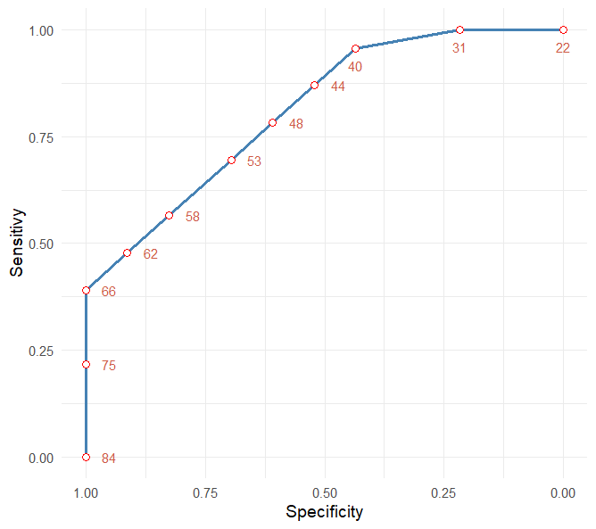
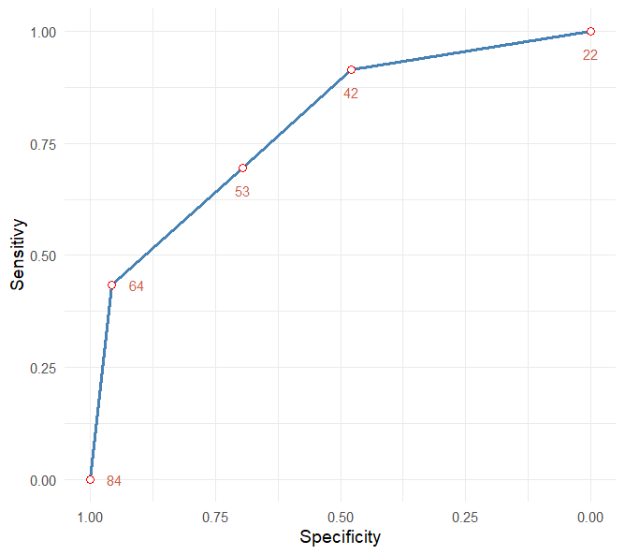
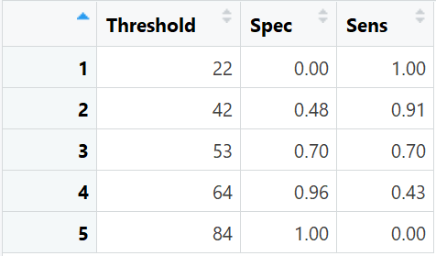
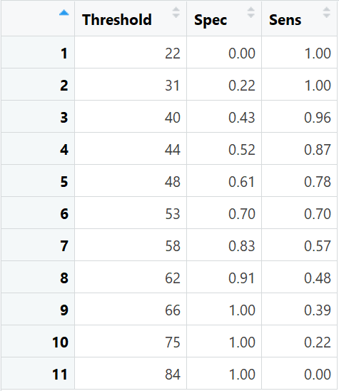
ROC Analysis
Example:

Slide 7
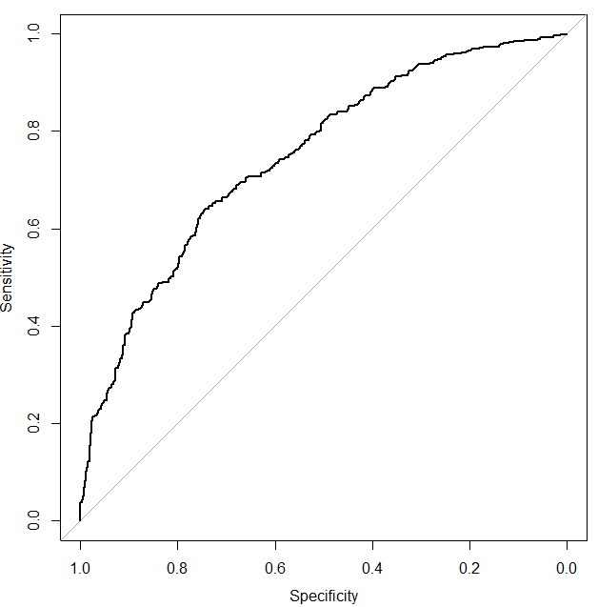
ROC Analysis
An example of a ROC curve in R.

Slide 8
ROC Analysis
Interpreting a ROC curve:
The closer the curve is to the left-hand and top borders, the more accurate the classifier.
The closer the curve is to the 45⁰ diagonal line, the less accurate the classifier becomes.
The optimal cut-off (may not be unique) is obtained at the point closest to the top-left hand corner.
Although a ROC curve is useful as a diagnostic tool, comparing two ROC curves can be challenging.
Notes:
AUC<.5 can occur if higher values of a variable are associated with lower probabilities of event.

Slide 9
ROC Analysis
Area Under the Curve (AUC)
The AUC (ranges between 0 – 1) is a measure of discrimination.
The closer it is to 1, the better the classifier.
AUC = 0.7 implies that there is a 70% chance the classifier is able to distinguish between the two classes.
AUC = 0.5 implies the classifier has no separation capacity.
Notes:
AUC is as the probability that the model ranks a random positive example more highly than a random negative example.
AUCROC can be interpreted as the probability that the scores given by a classifier will rank a randomly chosen positive instance higher than a randomly chosen negative one.

Slide 10
ROC Analysis
A rough guideline to interpreting AUC
0.9 – 1.0 (Excellent)
0.8 – 0.9 (Very good)
0.7 – 0.8 (good)
0.6 – 0.7 (fair)
0.5 – 0.6 (poor)
0.5 – throw it away
Notes:
AUC<.5 can occur if higher values of a variable are associated with lower probabilities of event.

Slide 11
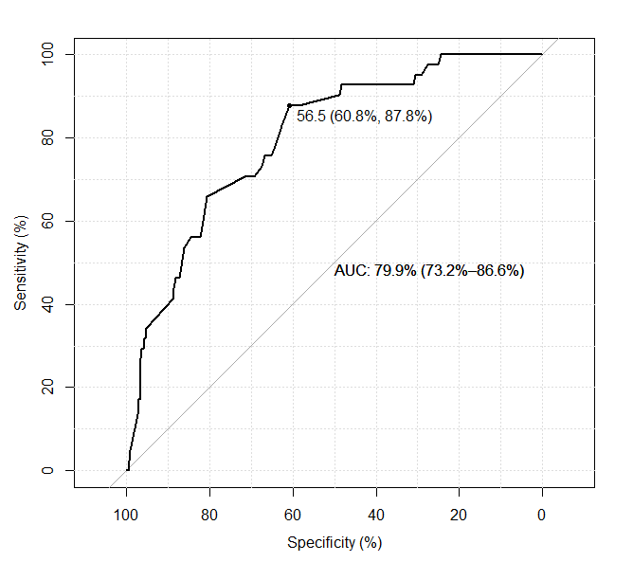
ROC Analysis
Example: COVID-19 Data

Slide 12
ROC Analysis
AUC in Machine Learning
AUC is an aggregate measure of performance of a classifier across all threshold values.
AUC is insensitive to imbalanced data.
AUC is preferred over “Accuracy” for imbalanced data.
Notes:
PR curve focuses on the minority class, whereas the ROC curve covers both classes.

Slide 13

ROC Analysis
Example: COVID-19 Data
41 of 421 (9.7%) cases resulted in death, i.e. imbalanced data
Logistic regression model – Based on a single threshold of 0.5.
AUC (Train) $=79.9\%$ and AUC (Test) $=80.7\%$
Preformance Measure | Train | Test
Specificity | 99.7% (379/380) | 100% (126/126)
Sensitivity | 0% (0/42) | 0% (0/13)
Accuracy | 90.0% (379/421) | 90.5% (126/139)
Notes:
AUC<.5 can occur if higher values of a variable are associated with lower probabilities of event.
AUC is as the probability that the model ranks a random positive example more highly than a random negative example.
AUCROC can be interpreted as the probability that the scores given by a classifier will rank a randomly chosen positive instance higher than a randomly chosen negative one.

Slide 14
ROC Analysis
Final Note on AUC in Machine Learning
AUC models the positive and negative classes.
AUC may not be the best measure for highly imbalanced data if the positive minority class is of interest only.
In these instances, the precision-recall (PR) curve is a better measure.
PR curves are also better for comparing models in imbalanced data.
Notes:
PR curve focuses on the minority class, whereas the ROC curve covers both classes.

